Slide 1
Mendix Handbook Overview

Slide 2
Agenda
1 | Mendix FAM Team Overview
2 | Mendix TAM Team Overview
3 | Monitoring Mendix Applications Overview

Slide 3
Mendix FAM Team Overview

Slide 4

Roles and Responsibilities – Mendix MO Support(FAM)
Monitoring Responsibilities :
Responsible for monitoring 45 Mendix applications as part of MO Support. Currently, monitoring is done via BMC Remedy, with a future transition planned to the NOVA tool.
Incident Management :
Responsible for providing timely resolutions for issues encountered in any of the 45 supported applications.
Incidents must be raised by end users or key users through EVA or the BMC Remedy tool with appropriate issue details.
Minor Change Requests :
Handle minor change requests that require development efforts of 8 hours or less.
Upgrade Validation Support :
Provide application-level validation support during infrastructure upgrade activities such as EKS upgrades, API upgrades, etc.

Slide 5
Roles and Responsibilities – Mendix MO Support(FAM)
Performance Monitoring :
Regularly check application performance using the built-in MxPerformance Bot feature available in Mendix.
Proactive Monitoring :
Support proactive monitoring by setting up error log alerts and dashboards using Grafana Monitoring Tool.
Key User Support:
Provide support to key users for service requests or master data configurations.
Integration Support (API/SAP):
Assist with initial analysis and resolution of issues related to API or SAP integration, especially those impacting application functionality.

Slide 6
Roles and Responsibilities – Mendix MO Support(FAM)
Mendix Minor Version Upgrades :
Responsible for executing and validating Mendix minor version upgrades across supported applications.
Mendix Major Version Upgrades:
Support Mendix major version upgrades in collaboration with the D&B (Development & Build) team.
Vulnerability Management :
Responsible for identifying and resolving vulnerabilities detected via:
Sigrid (QSM App Scan) – for Mendix-related application vulnerabilities.
Trivy Scan Tool – for broader application security issues.

Slide 7
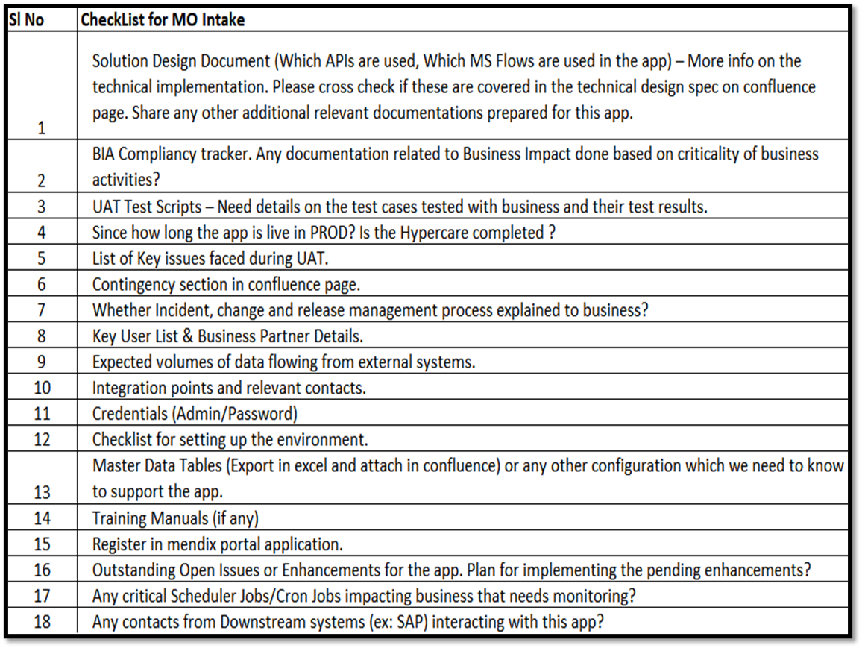
Roles and Responsibilities – Mendix MO Support(FAM)
Enrolment of new Mendix app for MO Support:
Enrolled a new Mendix applications after receiving knowledge transfer (KT) from the developer, along with all required documentation such as the design document, technical documentation, and UAT sign-off etcs.

Slide 8
Mendix TAM Team Overview

Slide 9
Mendix TAM Team Handbook Overview
Tools Used
Identify Responsibilities
Serve as Reference
Outline Operational Activities
Monitoring Mendix Applications Overview

Slide 10
AWS services/resource used for Mendix project
EKS
Hosts and scales Mendix application containers
API Gateway
Aurora PostgreSQL
Exposes infrastructure via MRT APIs to Mendix portal
Serves as the primary database for Mendix app data
S3
VPC
Stores static files and app generated documents
Isolates and secures the Mendix app network
IAM
EC2
Manages user/service permissions for Mendix resources
Hosts supporting services or custom workloads
WAF
Protects Mendix app from web exploits/attacks

Slide 11
Mendix App Deployment Strategies
CI/CD with Azure DevOps
Automates the build, test, and deployment process using Azure DevOps pipelines.
Docker Packaging
Git Source Code Management
Packages Mendix apps into Docker containers for Kubernetes deployment.
Manages Mendix modules and configurations using Git for version control.

Slide 12
Streamlining Operations with Programming
TypeScript
Applied for Infrastructure as Code (IAC)
Python
Used for automating Mendix operations and integrations

Slide 13
AWS Secrets and Configuration Management
AWS Secrets Manager
Securely stores and manages Admin, database credentials and constants.
AWS Systems Manager
Manages application configuration parameters efficiently.

Slide 14
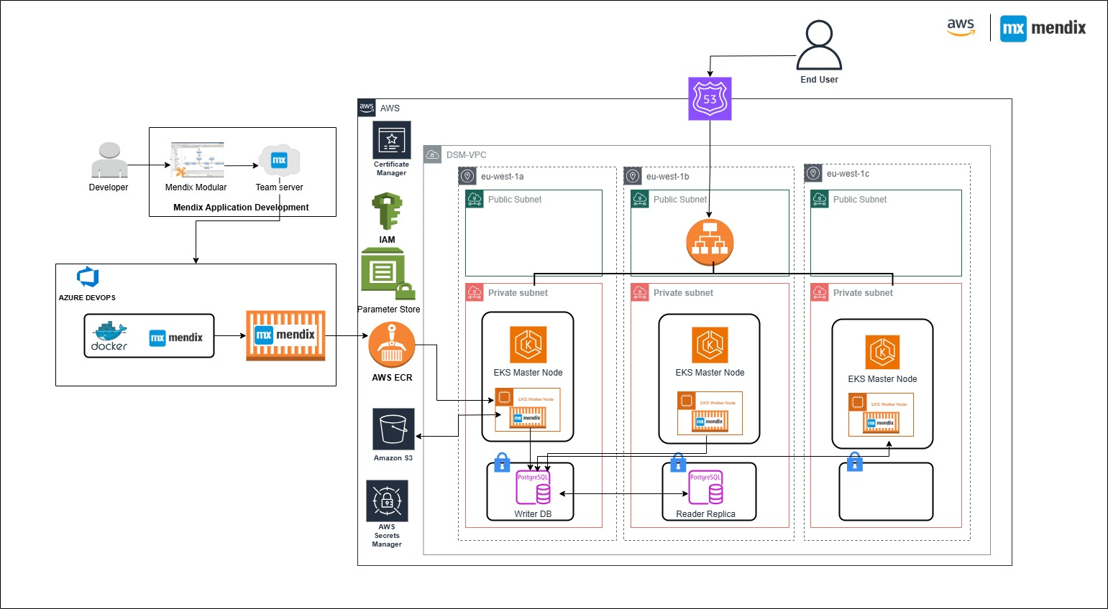
How Mendix Applications are Hosted

Slide 15
Maintenance Activities (Scheduled & Strategic)
Activity | Frequency / Trigger | Description
EKS Upgrades | Twice yearly | Upgrade Kubernetes cluster versions
Aurora Upgrades | Yearly | Upgrade PostgreSQL engine version
Monitoring Tools | Yearly | Upgrade Grafana, Mimir, Loki stacks
DR Simulation | Yearly | Conduct disaster recovery failover test
CI/CD Enhancements | On Release | Add new features from Azure DevOps updates
Node Resizing | As needed | Resize EKS instances based on resource needs
Infra Code Review | Yearly or major change | Ensure standards and performance
API Enhancements | As needed | Improve MRT-API feature as customer needed
OS Vulnerability Patching | Quarterly | Update Mendix base images via Trivy scan
Admin Credential Rotation | Quarterly | Enforce security hygiene (e.g., IAM, DB)
DB table Cleanup | weekly | Schedule, processed task and log table cleanup vi lambda script

Slide 16
Day-to-Day Operations (Proactive & Reactive)
Activity | Details
New App Onboarding | Configure infra, DNS, secrets, IAM, backup policies
Deployments (QA/Prod) | Support releases based on developer requests
DB Backup & Restore | Perform and share snapshots securely upon request
Debugger Enablement | Temporarily enable for troubleshooting
CPU/Memory Resource Tuning | Adjust based on CloudWatch/Grafana alerts
Secrets/Parameter Updates | Manage via AWS Secrets Manager & SSM
Infra Monitoring | React to alerts for EKS, Aurora, and app services
CI/CD Issue Troubleshooting | Pipeline failure resolution and support
Synthetic/APM/Infra Alerts | Fix app or infra issues using Grafana dashboards
Scheduler Adjustments | Configure app/DB stop/start during non-working hours
Application issue troubleshooting | Fix applications issues related to infra
ANH Carve-Out Support | Assist with separation planning, backups, migrations

Slide 17
Additional Notes
Proactive Measures: Alerts from Grafana and CloudWatch (RUM/Synthetics) are monitored regularly. The TAM team takes action on performance, availability, and security-related alerts as they arise.
Reactive Measures: All incidents are tracked via our internal ticketing system, with root cause analysis and long-term fixes applied where required.
Standard Operating Procedures & Runbooks: Detailed guides for TAM workflows, upgrade runbooks, infrastructure setup, monitoring configuration, and CI/CD support are available in the internal Confluence pages:
TAM Operations & Infrastructure Management
CI/CD setup & Monitoring Infrastructure
These documents cover how each activity is executed, tools used, troubleshooting steps, and reference configurations.

Slide 18
Monitoring Mendix Applications Overview

Slide 19
Comprehensive Monitoring and Alerting System
Alert manager
Trivy
Centralizes alerting and uses SMTP for email delivery
Security Scanning of app
container images done by Trivy
10
9
CloudWatch
Grafana Alloy
8
Scrapes Kubernetes metrics and pushes to Mimir
Stores RUM data and browser check metrics
1
CW Canaries
2
Mimir
Performs browser- based checks
7
Stores Prometheus- based metrics
3
Synthetic Checks
Loki
Runs HTTP checks via remote agents
6
Receives logs from applications
4
5
OpenSearch
Jaeger
Stores traces from Jaeger
Stores traces from OpenTelemetry agent

Slide 20
What We See – Real Examples
Infra
DB
Logs
http Synthetics
CloudWatch Synthetic
Captures CPU, memory, disk I/O, node health, pod status.
Monitors connections, latency, and slow queries.
Filterable in Loki with app, env, pod labels.
Checks uptime from server perspective.
Simulated user flows, response time, broken pages or login errors.
APM Metrics
APM Traces
User
RUM
Security scanner
Gathers JVM heap, GC time, response time, request errors via OpenTelemetry.
JDBC query spans visible in Jaeger.
Collects RUM data like page load time, JS errors, interaction delays.
Collects real user interaction metrics if enabled.
Trivy scans containers for vulnerabilities

Slide 21
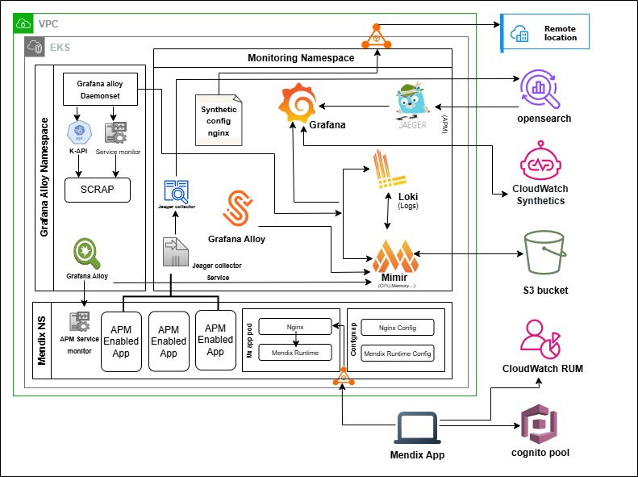
How the monitoring tools are hosted and integrations
Monitoring
APM
RUM
Infra
Synthetic

Slide 22
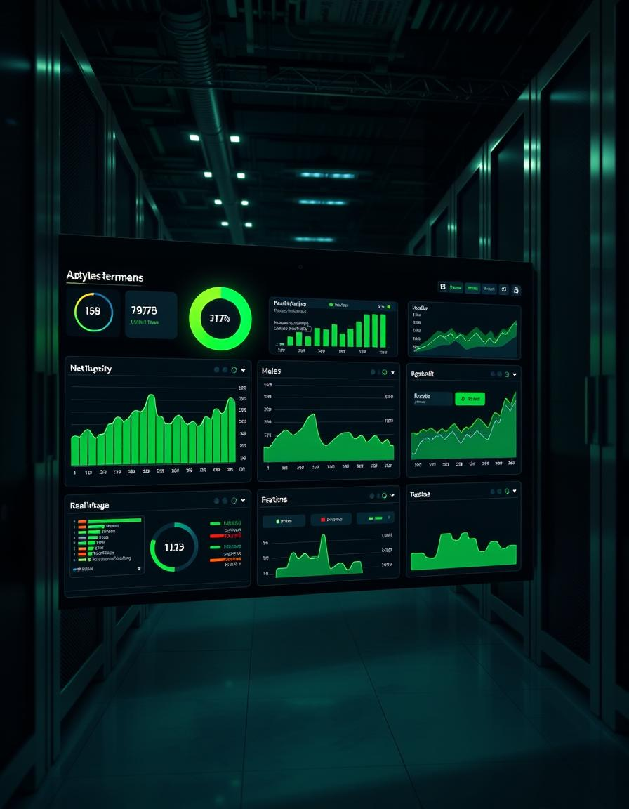
What & How We Monitor Mendix Applications
Platform: Mendix apps on AWS EKS Database: AWS Aurora PostgreSQL
Monitoring Area | Tool Used | Coverage
Logs | Grafana Loki | All apps
Metrics & Infra | Grafana (Alloy + Mimir) | All apps
Alerting | Mimir Alertmanager | All apps
Synthetic Monitoring | Grafana Alloy, CW Canaries | Alloy: All / Canaries: Critical only
Real User Monitoring | CloudWatch RUM | Critical apps only
Tracing / APM | Jaeger + OpenSearch | Critical apps only
DB Monitoring | CloudWatch Metrics | Mendix DB
Security Scanning | Trivy | All apps

Slide 23
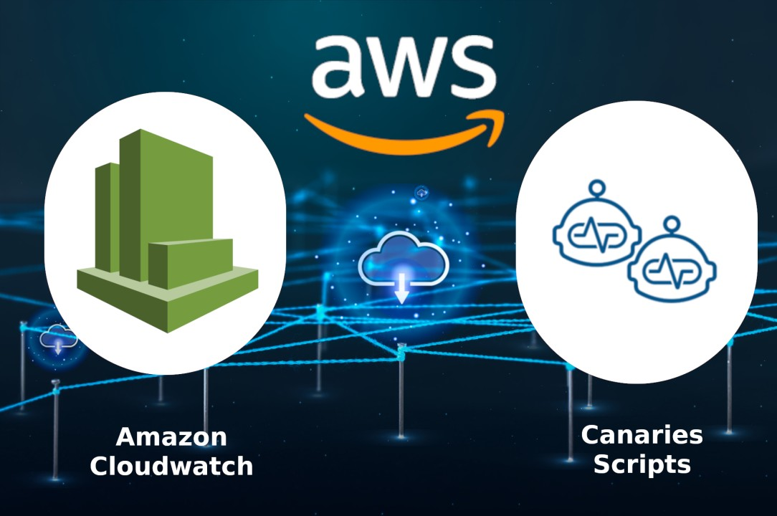
CloudWatch Synthetic enabled application lists
CloudWatch Synthetics run browser-based scripted tests (clickpaths) from defined locations to simulate user interactions and verify application uptime and core workflows. These tests help detect outages or performance degradation before real users are affected.
Sl No | CW synthetic enabled apps | Region code/Name
1 | certool | eu-west-1(Ireland), us-east-1(N. Virginia),sa-east-1(São Paulo) & ap-southeast-1(Singapore)
2 | creditportal | eu-west-1(Ireland), us-east-1(N. Virginia),sa-east-1(São Paulo) & ap-southeast-1(Singapore)
3 | budlepack | eu-west-1(Ireland)
4 | delvoanalytics | eu-west-1(Ireland), us-east-1(N. Virginia),sa-east-1(São Paulo) & ap-southeast-1(Singapore)
5 | mendixportal | eu-west-1(Ireland), us-east-1(N. Virginia),sa-east-1(São Paulo) & ap-southeast-1(Singapore)
6 | Mydsm | eu-west-1(Ireland), us-east-1(N. Virginia),sa-east-1(São Paulo) & ap-southeast-1(Singapore)

Slide 24
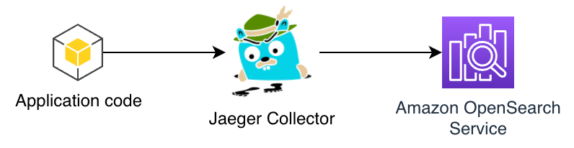
Application Performance Monitoring Enabled Applications
Sl No | APM enabled apps
1 | anh-pricing
2 | creditportal
3 | customermdm
4 | dfs-globalqc
5 | dfs-materials
6 | valuetracker
7 | dnpblockedstock
8 | fss-grir
9 | fss-hedging
10 | hof-approvals
11 | hof-ic
12 | hrss-contract
13 | hrss-vacation
14 | mdm-vendor
15 | pss-mail
16 | pss-mail2
17 | trust-it
18 | delvo-analytics
19 | Certool
20 | eapt
Application Performance Monitoring (APM) collects backend performance data—like JVM, memory usage, and database query times—through the OpenTelemetry Java agent attached to Mendix apps. the agent captures JDBC queries and JVM metrics. Trace data is sent to Jaeger, and metrics are available via Prometheus, integrated into Grafana dashboards.

Slide 25
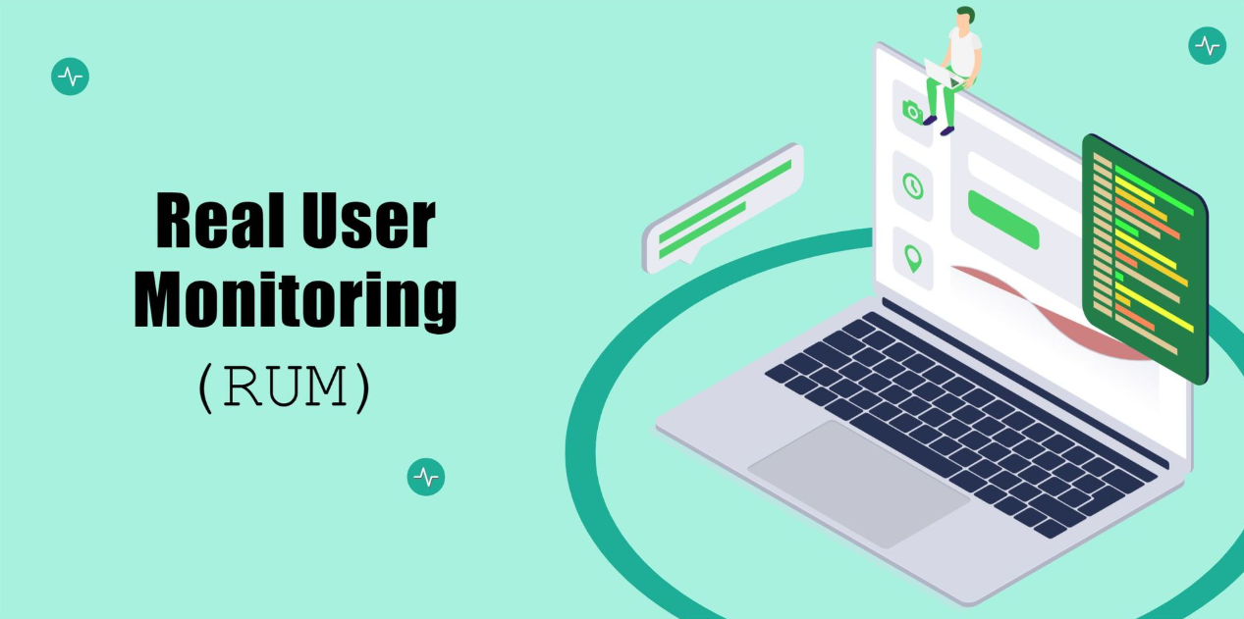
Real User Monitoring Enabled Applications
CloudWatch RUM monitors real user behavior by injecting a JavaScript snippet into Mendix apps at the NGINX level. It captures frontend metrics like page load time, user interaction latency, and errors directly from the browser
Sl No | RUM enabled apps
1 | anh-pricing
2 | creditportal
3 | customermdm
4 | dfs-globalqc
5 | dfs-materials
6 | valuetracker
7 | Dnpblockedstock
8 | fss-grir
9 | hof-approvals
10 | hof-ic
11 | hrss-contract
12 | hrss-vacation
13 | mdm-vendor
14 | pss-mail
15 | pss-mail2
16 | trust-it
17 | delvo-analytics
18 | certool

Slide 26
Responsibilities & Developer Contact Points
Task | Owner
Monitoring Tool Infra (setup, ops) | TAM Team (Gobi’s team)
Enabling/disabling monitoring per app | APM Team (Jyoti & Ayushi)
Dashboard Creation | APM Team (Jyoti & Ayushi)
Developer Support | Both TAM & APM Teams
Reporting alerts to user | dsm-hcl-commandcenter@dsm-firmenich.com
🔔 Developers should contact APM Team (dsm-devops-apm@dsm-firmenich.com ) to enable/disable monitoring for their app, to get grafana access & dashboard creation.
🛠️ TAM team manages the monitoring infrastructure (Gobi.m@dsm-firmenich.com , Suhas.Kalyanrao-Patil@dsm-firmenich.com & Kushagra.Patel@dsm-firmenich.com)
What TAM Can Help With: ✅ Infra health, infra-alert triage, issue analysis, log/metric queries
❌ App code issues, enabling/disabling monitoring, dashboard creation, access (APM does that)

Slide 27
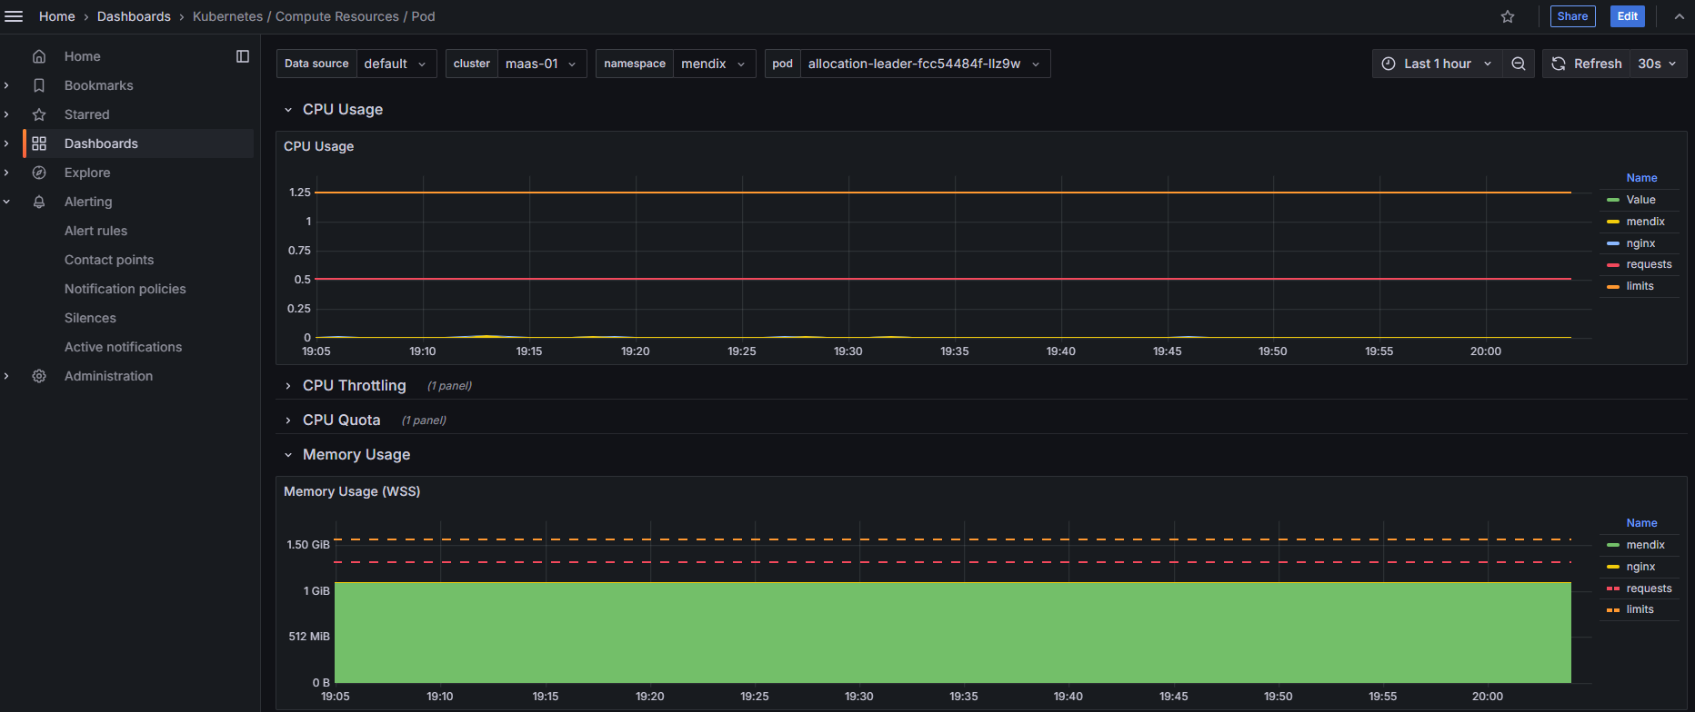
Application pod’s memory & CPU utilization

Slide 28
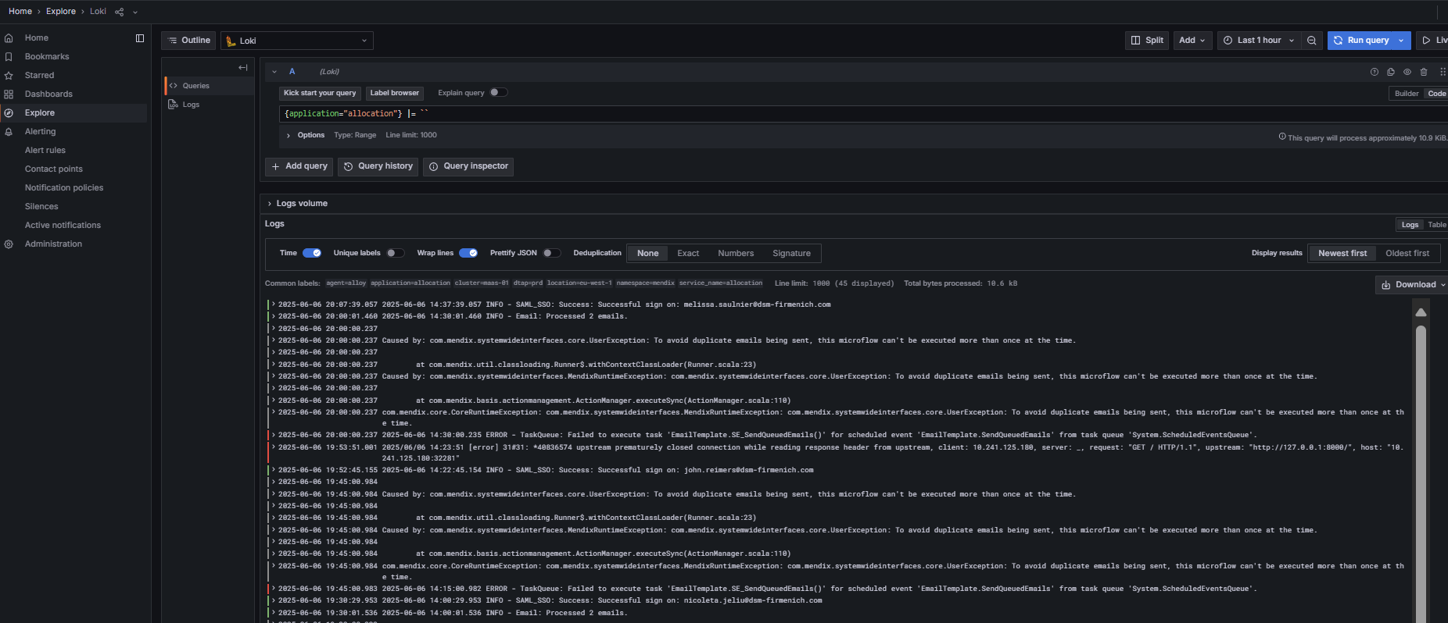
Mendix Application’s logs

Slide 29
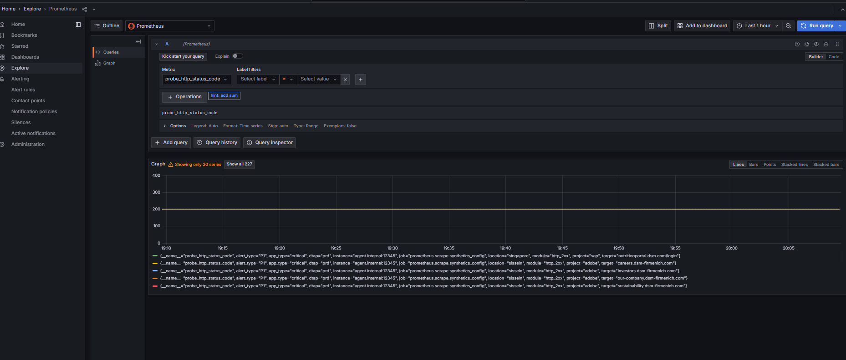
Grafana alloy synthetic status code

Slide 30
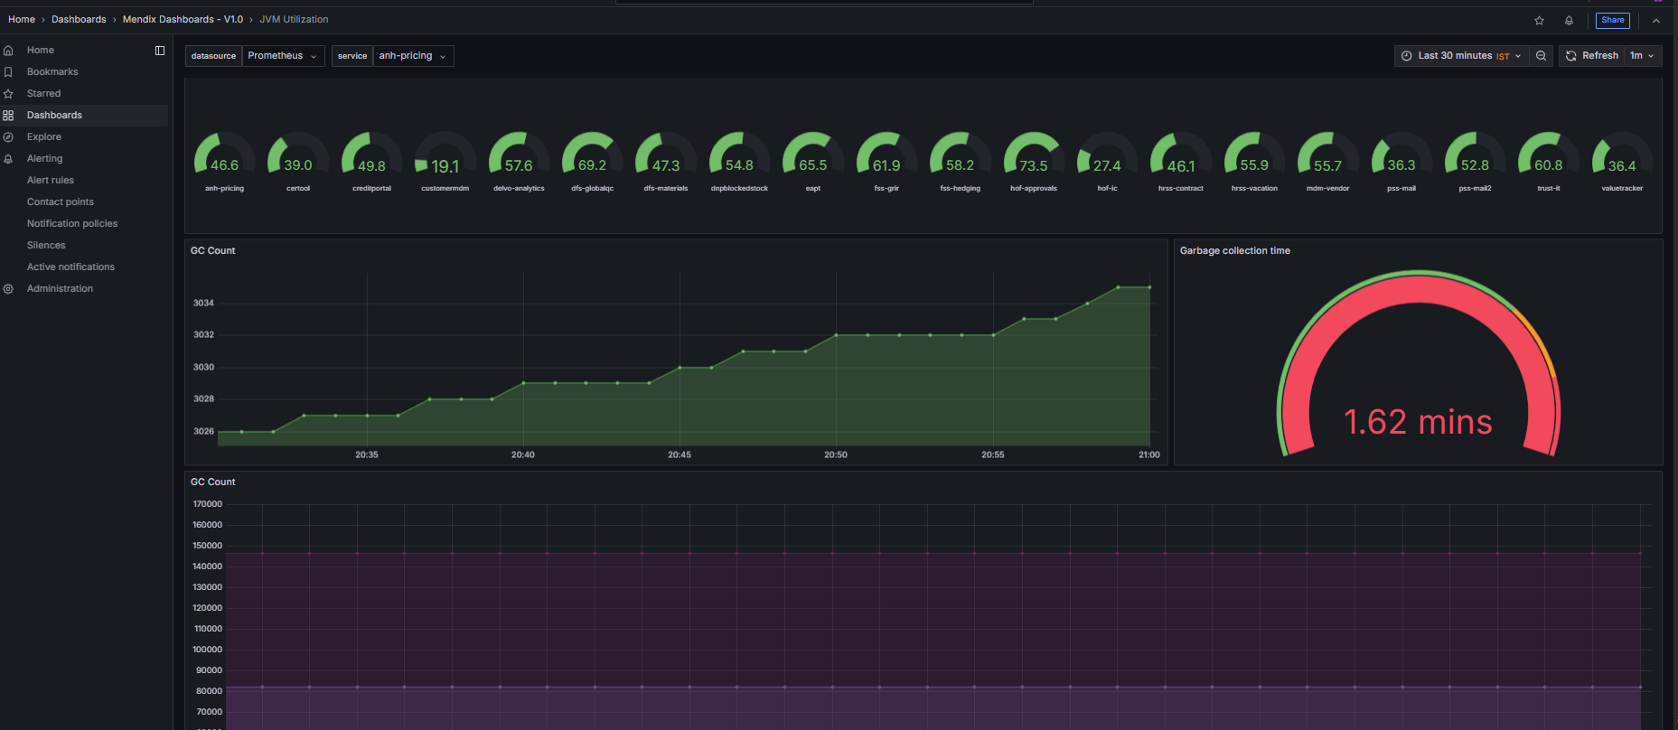
JVM utilization and garbage collection via APM

Slide 31
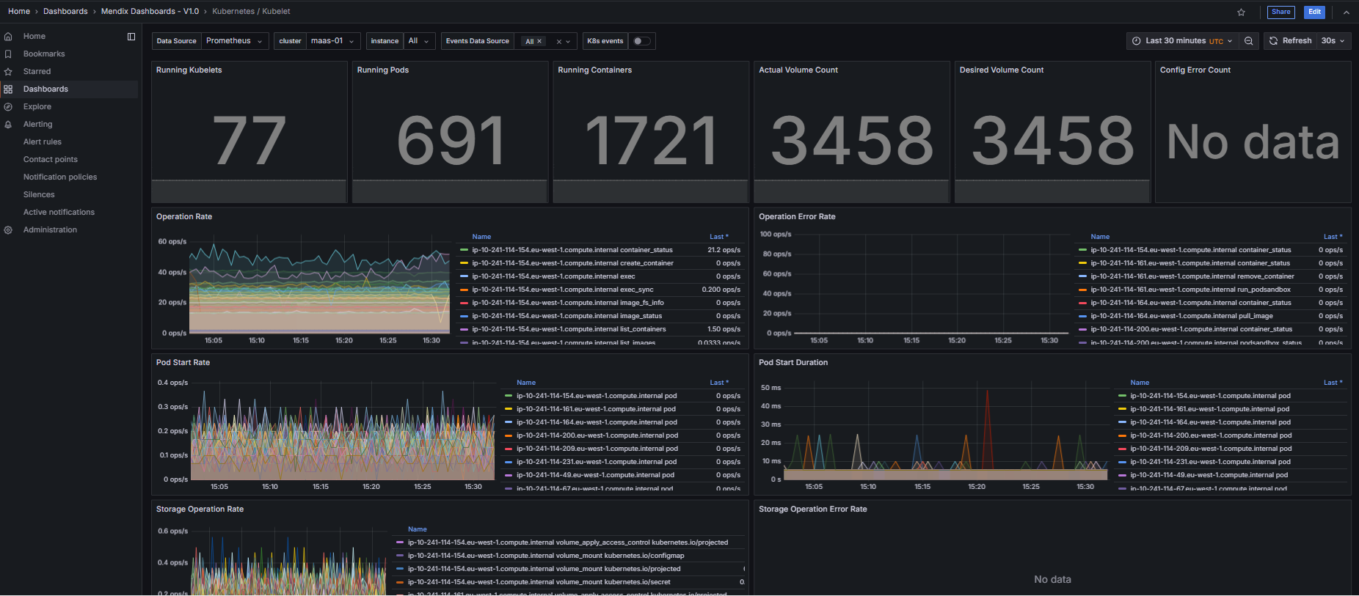
Kubernetes metrics

Slide 32
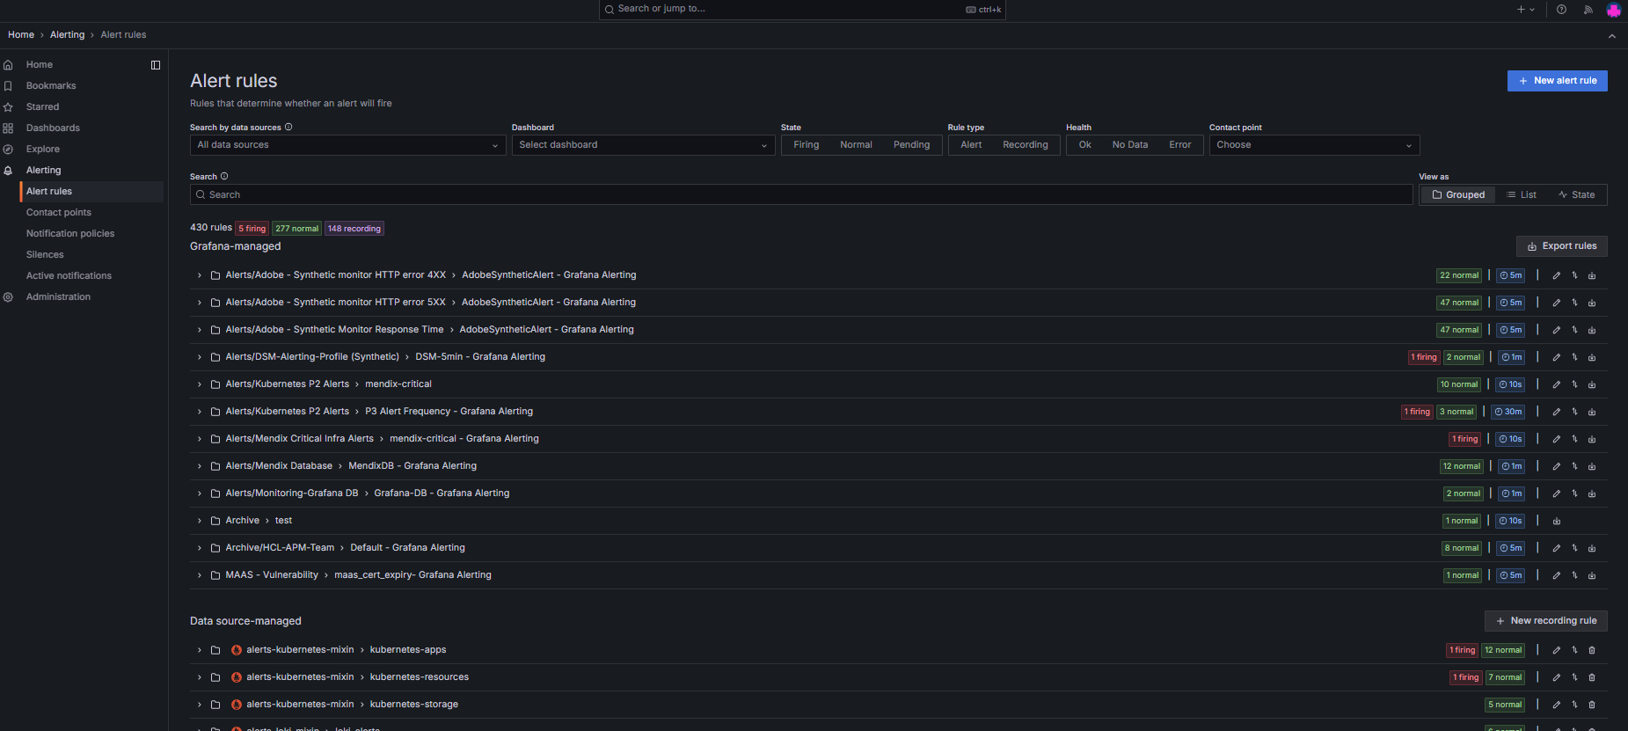
Grafana Alerts

